Slide 1

The importance of vocabulay

Slide 2
Verbal communication: key elements
Physical (voice, body language)
Linguistic (vocabulary, syntax, register, rhetorical techniques)
Cognitive (content, structure, reasoning)
Social/Emotional (confidence, audience/conversation partner awareness, working with others, listening/responding, turn-taking)

Slide 3
Why is vocabulary important?
Links the spoken word to the written word.
Difficulties with oral language can impact behaviour, mental health and academic attainment.

Slide 4
Does spoken language matter?
Language difficulties are the most common special need identified in the early years.
Speech, Language, Communication Needs (SLCN) account for 22% of children on the SEN Register across the country (DfE, 2019); the top identified need.
Difficulties are more prevalent for children from socially deprived areas.

Slide 5
Does vocabulary matter?
Life stage | Outcomes
Poor vocabulary age 2 | Do less well academically and socially at 6 Reading less well at 7
Poor vocabulary age 5 | Twice as likely to be unemployed in their 30s One and a half times more likely to have mental health issues
Poor communication & spoken language age 5 | Less likely to enjoy school at age 7 6x less likely to do well in English 10x less likely to do well in maths at age 11
Source: ‘Talking About A Generation’ (2017)

Slide 6
Workshop activity
Can you arrange vocabulary norms by age?

Slide 7
Typical spoken vocabulary norms: primary
Age 4 to 5 | 5 to 7 | 7 to 9 | 9 to 11
Understands a range of related words to describe concepts. | Compares words, the way they look, sound or mean. | Uses a range of words related to time & measurement. | Makes choices from a wide and varied vocabulary.
Knows words can be put into groups (categories). | Can guess the word from clues, or give others clues using shape, size, function. | Uses a wide range of verbs to express their thoughts or about cause/effect. | Uses sophisticated words but the meaning might not always be accurate.
Uses words more specifically to make the meaning clearer. Source: The Communication Trust | Uses newly learnt words in a specific & appropriate way. | Joins in discussion about an activity using topic vocabulary. | Knows that words can have two/more meanings & uses appropriately, but can’t always explain how they are linked.

Slide 8
Typical spoken vocabulary: secondary
Age 11 | Age 14 | Age 18
Instruction words are hard to understand e.g. estimate, research. | Still challenged by some instruction words e.g. modify, consider. | Knows what these instruction words mean: compile, evaluate, find themes.
Understands some words have multiple meanings e.g. bright, hot | Uses patterns in words e.g. suffixes such as –esque, -able and prefixes such as dis-, un-. | Uses a wide range of descriptive words and expressions e.g. swaggered, meandered.
Beginning to use dictionary type definitions rather than those based on personal experience. | Uses ‘academic’ words when prompted for formal work e.g. agitated, excruciating.
Uses more interesting vocabulary when prompted e.g. worried becomes anxious. | Can confidently explain the meanings of subject vocabulary and words with multiple meanings. | Source: The Communication Trust

Slide 9
What can we do together to improve spoken language at our schools?
In pairs/groups discuss:
What explicit activities do you carry out daily to foster a love of spoken words in children?
How many new words do you teach every day to children? How often are the words spoken and consolidated?
Are dictionaries freely available in your classroom? How often do you build in dictionary and thesaurus work?

Slide 10
Three-pronged approach
Communication friendly classrooms (applying learning from our first workshop)
Focus on explicit vocabulary teaching – STAR approach
Encourage independent vocabulary learning
Notes:
Spoken vocabulary = Critical building block of spoken and written language
Vocabulary impacts children’s outcomes
A child needs to acquire on average 3000 new words a year
Supports communication with peers

Slide 11
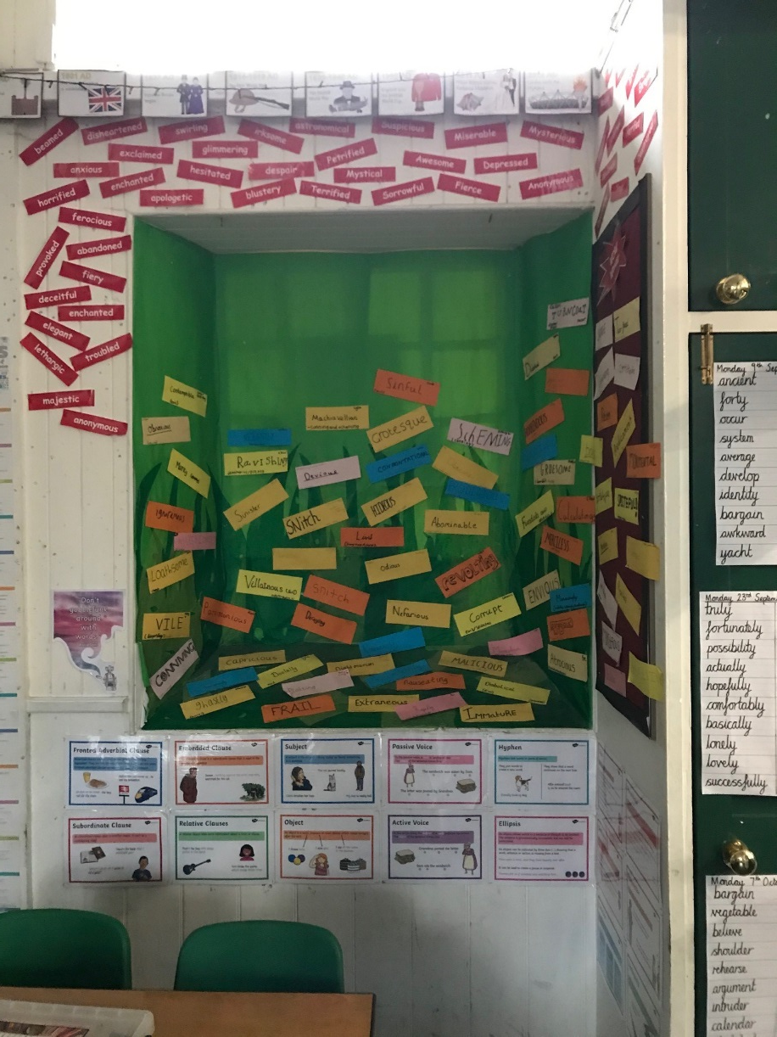
Communication friendly classrooms

Slide 12
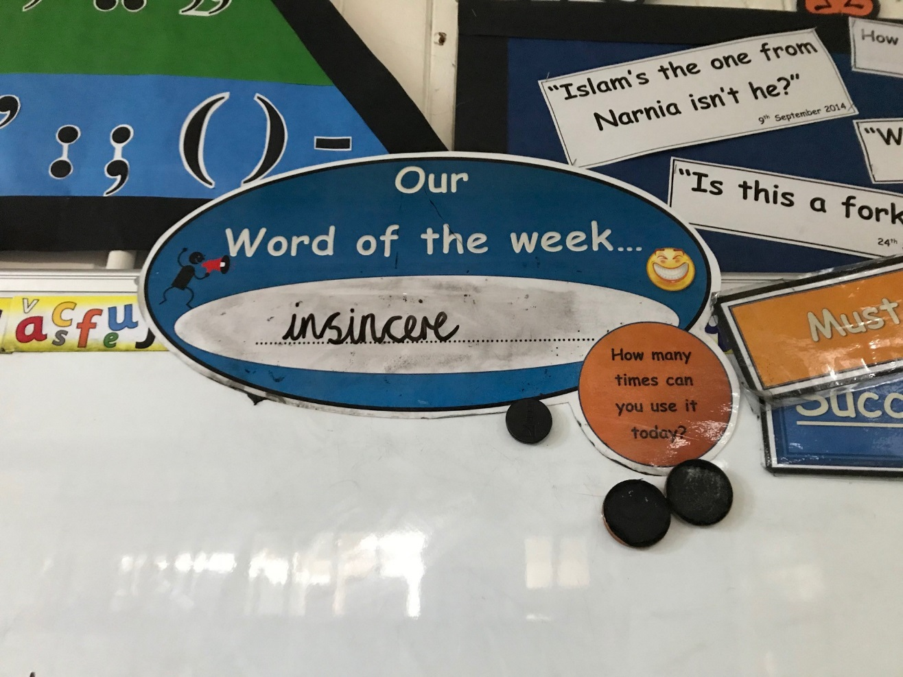
Communication friendly classrooms

Slide 13
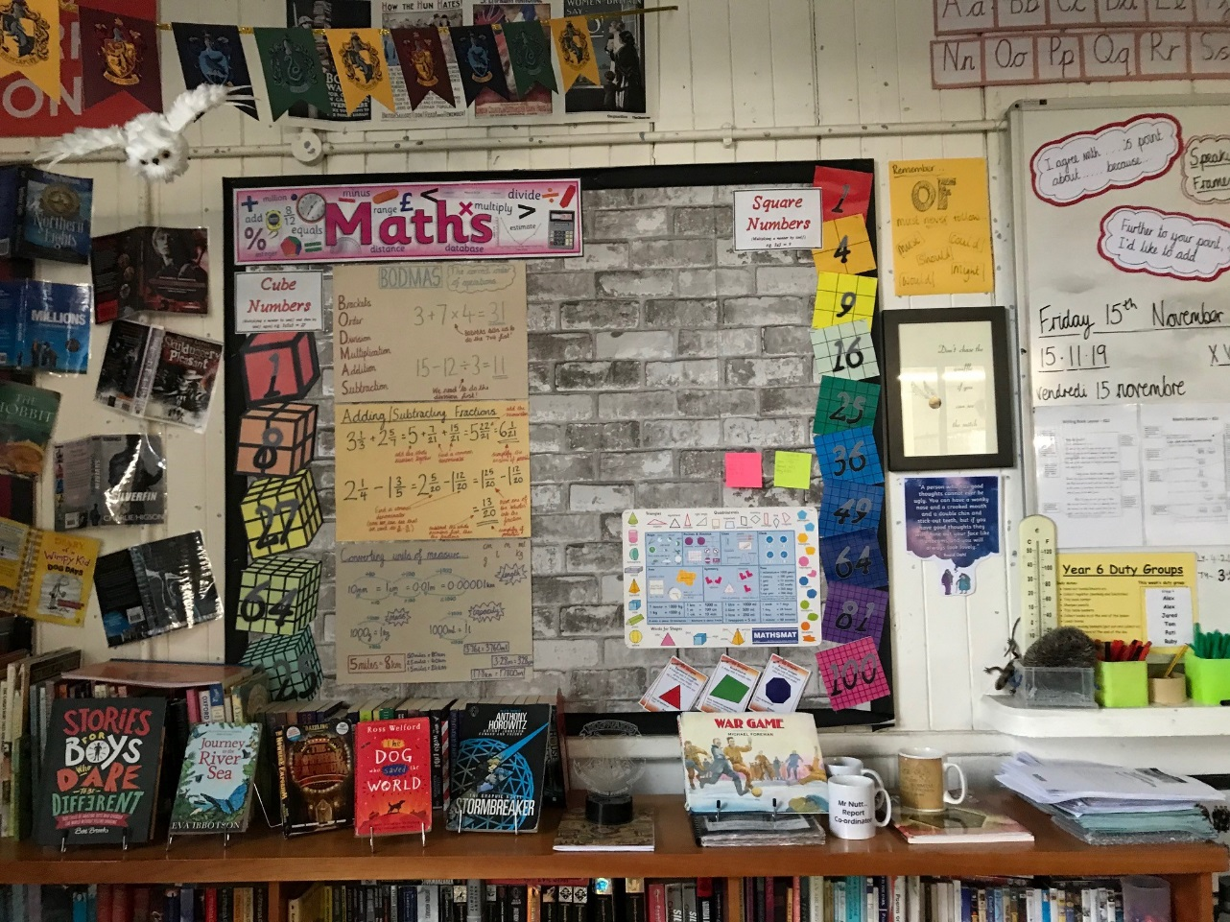
Communication friendly classrooms

Slide 14
Communication friendly classrooms
Word of the week
Working word wall – children have written these words themselves
Reflection….
Do you have a ‘word of the week?’ If so, how many times did you and children use the word of the week?
Do you have a ‘working word wall’ and how often do you refer to it?
Are written words supported by visuals, symbols in your class?

Slide 15
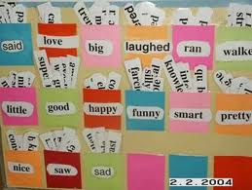
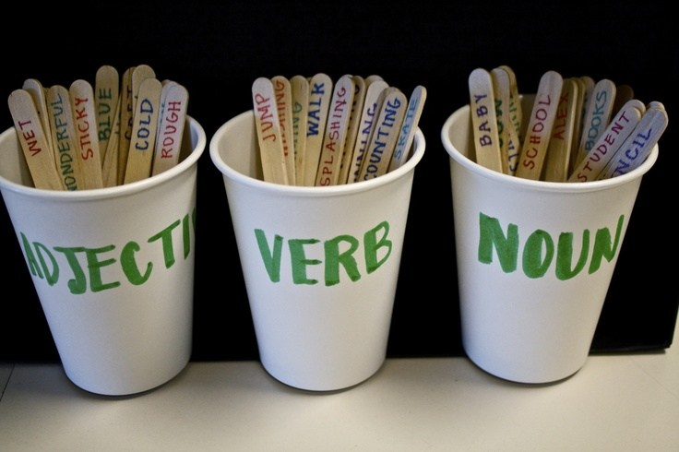
Communication friendly classrooms
Working Word Wall
    Give a clue
    Say it in a sentence
Word Pot
  Act it out
Word Learning Checklist

Slide 16
Explicitly teaching vocabulary
Word Aware Programme: STAR Approach
Select
Teach
Activate/Activity
Review
Modified from Blachowicz and Fisher ( 2010 )

Slide 17
STAR - Select
Anchor words (Most children know) | Goldilocks words (Not too easy or too hard, but just right) | Step on words (Topic-specific)
Everyday basic familiar words, used frequently (e.g. clock, happy, school). | Words describing a basic concept in greater detail e.g. agony, tedious, hideous. (Very useful for literate language). | Subject-specific words (e.g. cytoplasm, apparatus, ecosphere, pivot).
 | ‘Process’ vocabulary used across several or all subjects (e.g. participation, design, construct, defend, estimate, describe).
High frequency Often no need to teach | High frequency Rarely taught | Low frequency Often taught

Slide 18
STAR – Select Over to you
From Y4 topic, a village in India
Put the following into 3 categories: anchor, goldilocks, step on words.
country, continent, route, monsoon, river, distance, weather, home, cash crop, family, economic activity, village, key, landscape, climate, crops, remote, symbol, hill, houses, occupation, nucleated, market town, settlement, city, road, linear, trade, airport, agriculture

Slide 19
Were you right?
Anchor words | Goldilocks words | Step on words
Country, village, city, hill, river, weather, road, airport, home, houses, family | Continent, landscape, climate, route, distance, agriculture, crops, remote, symbol, key, occupation, trade, market town | Settlement, monsoon, nucleated, linear, cash crop, economic activity

Slide 20
STAR – Teach
STAR topic teaching sequence
  Symbol/Picture/Photograph
  Phonology (sound)
  Semantics (meaning)
  Put it in a sentence
  Action
  Song
  Working word wall
  Word Pot

Slide 21
STAR – Teach – Using The Word Wizard

Slide 22
STAR – Teach – Using The Word Wizard

Slide 23
STAR - Activate
Might look a lot like your normal lesson but:
Adults use the word many times
Prompt children to use the word
Link vocabulary to activity

Slide 24
STAR – Review
Reviewing words helps words fix into the child's long-
term memory. This needs to be done at the end of the
lesson and also at various times such as:
  following week
  end of the half term
  next term
Word Pot, Discussion, Stickers home, Games,
Fortune Teller, Pass the Object

Slide 25
STAR summary
Select- pick a goldilocks word as word of the day.
Teach- the word to the whole class, use word wizard sheet.
Activate- use the word in the lesson linked to what the children are doing many times and encourage them to use it too.
Review- word pot, discussion, stickers home/fridge words, games.

Slide 26
Fostering independence
Vocabulary Self-rating Scale
Word Games e.g. Pass the bomb, The 5-second Rule
Use of ‘Vocabulary Learning Checklists’
Vocabulary Notebook
Taking responsibility for new words e.g. through use of dictionary / thesaurus
Fridge Words
Reading Book Challenge (bookmark in resource pack)

Slide 27
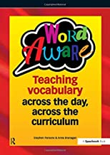
Resources
Word Aware
(Speechmark Publishing)
Today’s resource pack
including blank lesson plan, lesson example,
Black Sheep Press vocabulary learning check list,
word web, word pot template,
reading book challenge book mark,
vocabulary self-rating scale, fridge words,
fortune teller, working word wall template.

Slide 28
Further CPD
Communication Trust: An Introduction to Speech, Language and Communication (Short Online Course, approximately 3 hours to complete)
https://www.thecommunicationtrust.org.uk/projects/professional-development/online-short-course/

Slide 29
Further reading
UCL WORD Project (2017, randomised control trial, semantic and phonological word webs).
https://discovery.ucl.ac.uk/id/eprint/1567738/7/Best_01-08-2017_Interventi.pdf
‘Talking About A Generation’ Report (2017)
https://www.thecommunicationtrust.org.uk/media/540327/tct_talkingaboutageneration_report_online.pdf

