Slide 1
Supporting Vocabulary Development in School

Slide 2
Why is Vocabulary so important?
Notes:
Ask them to think about it/share ideas/discuss in pairs

Slide 3
Why Vocabulary Matters
Vocabulary, the words a child understands, is the foundation of all other language skills.
A child must reach a certain level of vocabulary development before they can begin joining words to express ideas, answer questions and state preferences.
This has an impact on processing, attention and ability to follow instructions and learn.
It also has an affect on their interaction with peers and adults.

Slide 4
Facts and Figures
Life stage | Outcomes
Poor vocabulary age 2 | Do less well academically and socially at 6 Reading less well at 7
Poor vocabulary age 5 | Twice as likely to be unemployed in their 30s One and a half times more likely to have mental health issues
Poor communication & language age 5 | Less likely to enjoy school at age 7 6x less likely to do well in English 10x less likely to do well in maths at age 11
Source: ‘Talking About A Generation’ (2017)
Notes:
Here are some worrying facts about the impact of a poor vocabulary.

Slide 5
Facts and Figures
Children with poor vocabulary are twice as likely to be unemployed in adulthood (Bercow Review 2018)
60% of young offenders have low language skills.

Slide 6
A vicious cycle
Child has a high vocabulary
Reads more because it’s less challenging
Further increase vocabulary
Child has a low vocabulary
Reads less because it’s challenging
Vocabulary grows slowly
Notes:
There is great variation in children’s vocabularies. Without support, this gap is likely t widen because (read from slide).

Slide 7
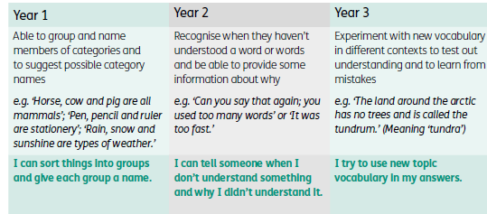
The Communication Trust.
http://www.thecommunicationtrust.org.uk/media/438907/tct_commthecurric_poster_3.pdf
Notes:
Guidelines for what is expected at each age can be found on the communication trust website:

Slide 8
STAR Approach
Select
Teach
Activate/Activity
Review
Modified from Blachowicz and Fisher ( 2010 )
Notes:
We’re now going to take you through the STAR approach, which is a way of supporting vocabulary.

Slide 9
STAR-Select - Primary
Anchor words (Most children know) | Goldilocks words (not too easy or too hard but just right.) | Step on words (topic specific)
Everyday basic familiar words, used frequently (e.g. clock, happy, school) | Words describing a basic concept in greater detail e.g. agony, tedious, hideous. (very useful for literate language. | Subject-specific words (e.g. cytoplasm, apparatus, ecosphere, pivot)
 | ‘Process’ vocabulary used across several or all subjects (e.g. Participation, design, construct, defend, estimate, describe)
High frequency No need to teach | High frequency Rarely taught | Low frequency Often taught
 | Beck, Mckeown and Kucan (2002)
Notes:
The first step is to select the words, and to categorise them into….

Slide 10
STAR – Select
Put the following into 3 categories: anchor, goldilocks, step on words.
country, continent, route, monsoon, river, distance, weather, home, cash crop, family, economic activity, village, key, landscape, climate, crops, remote, symbol, hill, houses, occupation, nucleated, market town, settlement, city, road, linear, trade, airport, agriculture
Notes:
ACTIVITY: Lets imagine that we’re soon going to be teaching Year 4 about a village in India. Here are the words we’ve selected, can you now use your sheets to sort them into Anchor words, Goldilocks words and Step on words. This could be done in pairs/small groups.

Slide 11
A Village in India: Year 4
Anchor words | Goldilocks words | Step on words
Country, village, city, hill, river, weather, road, airport, home, houses, family | Continent, landscape, climate, route, distance, agriculture, crops, remote, symbol, key, occupation, trade, market town | Settlement, monsoon, nucleated, linear, cash crop, economic activity

Slide 12
STAR – Teach
STAR topic teaching sequence
Symbol/Picture/Photograph
Phonology (sound) clap, rhyme, initial sound, say to partner
Semantics (meaning)
Put it in a sentence
Action
Song
Working word wall
Word Pot
Notes:
There are lots of ways of teaching new words (read from slide)
Research shows that if you use both semantic and phonological information about the new words to link new words to existing knowledge, child is more successful in learning the word.

Slide 13
Sample of vocabulary learning sheet
What does it do? What do you do with it?
What does it look like?
How many syllables?
Word
Where do you find it?
What does it start with?
What group does it belong to?
What does it end with?
What does it rhyme with?
Notes:
Research shows that if you use both semantic and phonological information about the new words to link new words to existing knowledge, child is more successful in learning the word.
This sheet can be used 1:1 or as a whole class, to talk about new words.

Slide 14
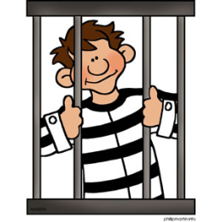
Sample of vocabulary learning sheet
Can you put it in a sentence?
‘The gang made their escape’
How many syllables?
2
ESCAPE
What does it mean?
To break free or break out.
What does it start with?
e
What group does it belong to?
Noun or verb
What does it rhyme with?
Landscape, seascape, reshape
What does it end with?
e

Slide 15
Notes:
Here is a simpler version

Slide 16
STAR – Activate
Might look a lot like your normal lesson but:
Adults use the word many times
Prompt children to use the word: For information to pass from our short to long-term memory it must be used rather than simply heard or seen.
Link vocabulary to activity
Notes:
Once you’ve Selected and Taught the words, it’s time to help the children remember them….

Slide 17
STAR – Review
Reviewing words helps words fix into the child's long term memory. This needs to be done at the end of the lesson and also at various times such as:
following week
end of the half term
next term
Ways of reviewing: Word Pot, Discussion, Stickers home, Games, Fortune Teller, Pass the Object
Notes:
Word Pot: The words learnt throughout the week or term can be put in a pot. At the end of the week or term, children can take it in turns to pick one out and give clues to the rest of the class about what word they have found.
Fortune Teller – Select a topic and then choose four words from that topic. Write these on the 4 outside squares of the fortune teller. To play – a player chooses a word, the fortune teller spells out the word in time to the movement of the fortune teller. When the word has been spelt four numbers will then be displayed. The player selects one of these. The fortune teller is again moved in time to the numbers being counted. Once the counting is completed a further number is selected. The corresponding flap is lifted and the question is left out.

Slide 18
STAR topic summary
Select- pick a goldilocks word.
Teach- the word to the whole class-word wizard sheet.
Activate- use the word in the lesson linked to what the children are doing many times and encourage them to use it too.
Review- Word pot, discussion, stickers home (fridge words), games
Notes:
To summarise…

Slide 19
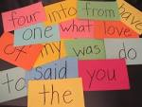
How can we make our classrooms word friendly and how do we teach words?

Slide 20
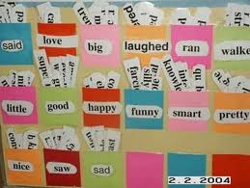
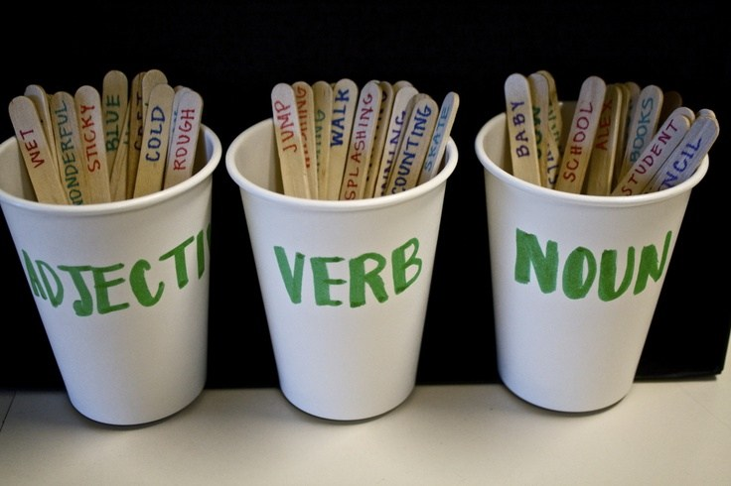
Make your classroom Vocabulary Friendly
Working Word Wall
Give a clue
Say it in a sentence
Word Pot
Act it out
Word Learning Checklist
Notes:
Create interactive/working wall displays
Display whole class vocabulary choices using pictures of children with speech bubbles
Provide a range of quality text and text types to extend the children’s interests
Capture new, exciting & unusual vocab for later use
Good discussion point for classroom displays
20

Slide 21
Whole class approaches
Plan for the introduction of new vocabulary in short term plans
Have a ‘word of the day’ – use it in context as many times as possible
Build up word families-Create a working word wall.
Pre-teach vocabulary before introducing it in a story or topic
Support their auditory memory and retention with visuals.
Notes:
An example of a word family could be the -ing’ family.
Pre-teaching – not just 1:1, can be done as a whole class.

Slide 22
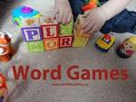
Vocabulary in independent tasks
Vocabulary Self-rating Scale
Word Games e.g. Pass the bomb
Use of ‘Vocabulary Learning Checklists’
Vocabulary Notebook
Taking responsibility for new words e.g. through use of dictionary / thesaurus
Fridge Words
Reading Book Challenge
Notes:
22

Slide 23
Action Plan
Lots of information given but how can you go away from today and use it?
Make yourself an action plan that could be used from tomorrow….
Think of examples of step-on words for your current topic that can be introduced with a word map and put in a word pot!
* Please activate your plan prior to referral to Speech & Language Therapy

